Slide 1
Data Analysis
Data Manipulation Techniques: Assignment 4
Submitted to: Shannon Mulligan

Slide 2
HELLO!
I am Alvira Narshidani
Student ID: 200394236

Slide 3
DIRECTORY
Introduction to the topic
Description of data
Questions
Analysis
Results
Conclusion

Slide 4


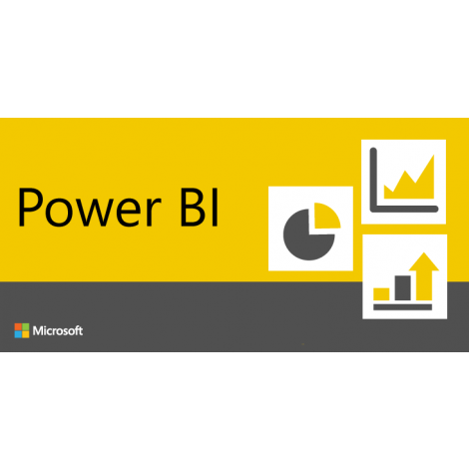
INTRODUCTION
Notes:
Waikato Environment for Knowledge Analysis (Weka) is a suite of machine learning and a collection of visualization tools and algorithms for data analysis and predictive modeling.
SQL Server Reporting Services (SSRS) is a server-based report generating software system which can be used to prepare and deliver a variety of interactive and printed reports.
Power BI has business intelligence capabilities where end users can create reports and dashboards by themselves, without having to depend on information technology staff or database administrators. Moreover, it is adaptive and responsive which can cross filter when clicked on charts.

Slide 5
DESCRIPTION OF DATASET
Attribute Name | Data Type
State | String
Postal Code | String
Region | String
Product ID | String
Category | String
Sub – Category | String
Product Name | String
Sales | Numeric
Quantity | Numeric
Discount | Numeric
Profit | Numeric
The Super Store Sale dataset relates the shopping sample records for testing. It gives an idea to enhance the company databases.
21 Fields
9995 Records
Notes:
The Super Store Sale dataset relates the shopping sample records for testing. It gives an idea to enhance the company databases.
Furthermore, it gives information about a company's profits, sales, products based on a region.
It has around 9000 records and 21 attributes.
The analysis discusses various measures like sales, quantity and dimensions like categories, sub-categories and regions of United States.

Slide 6
QUESTIONS
How will the company know the outliers in the data?
How will the manufacturing department realize about their production quantity?
How will the company know about maximum sales to build strategies?

Slide 7
How will the company know the outliers in the data?
Analysis1

Slide 8
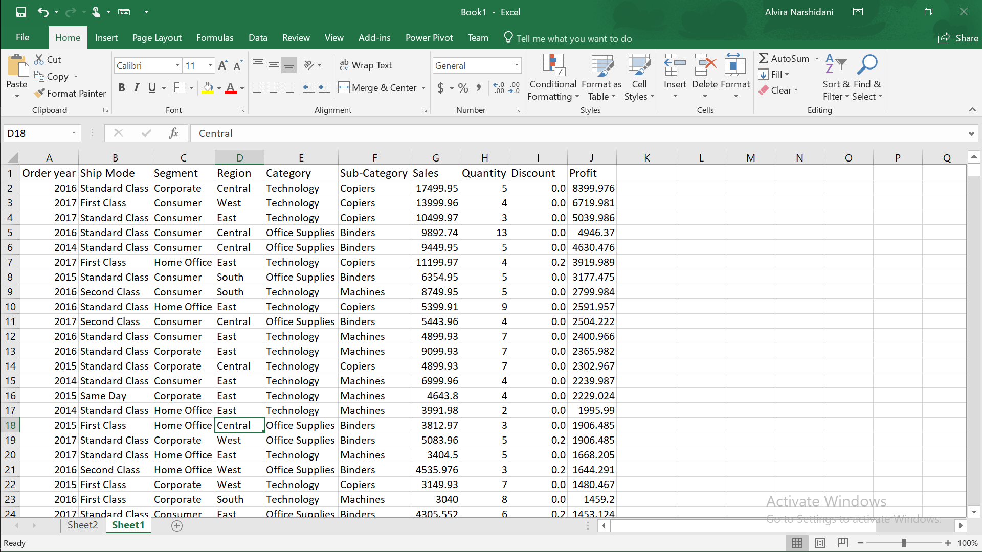
Notes:
Cleaning of data by removing customer and product general details by only selecting needed data columns to analyze further.

Slide 9
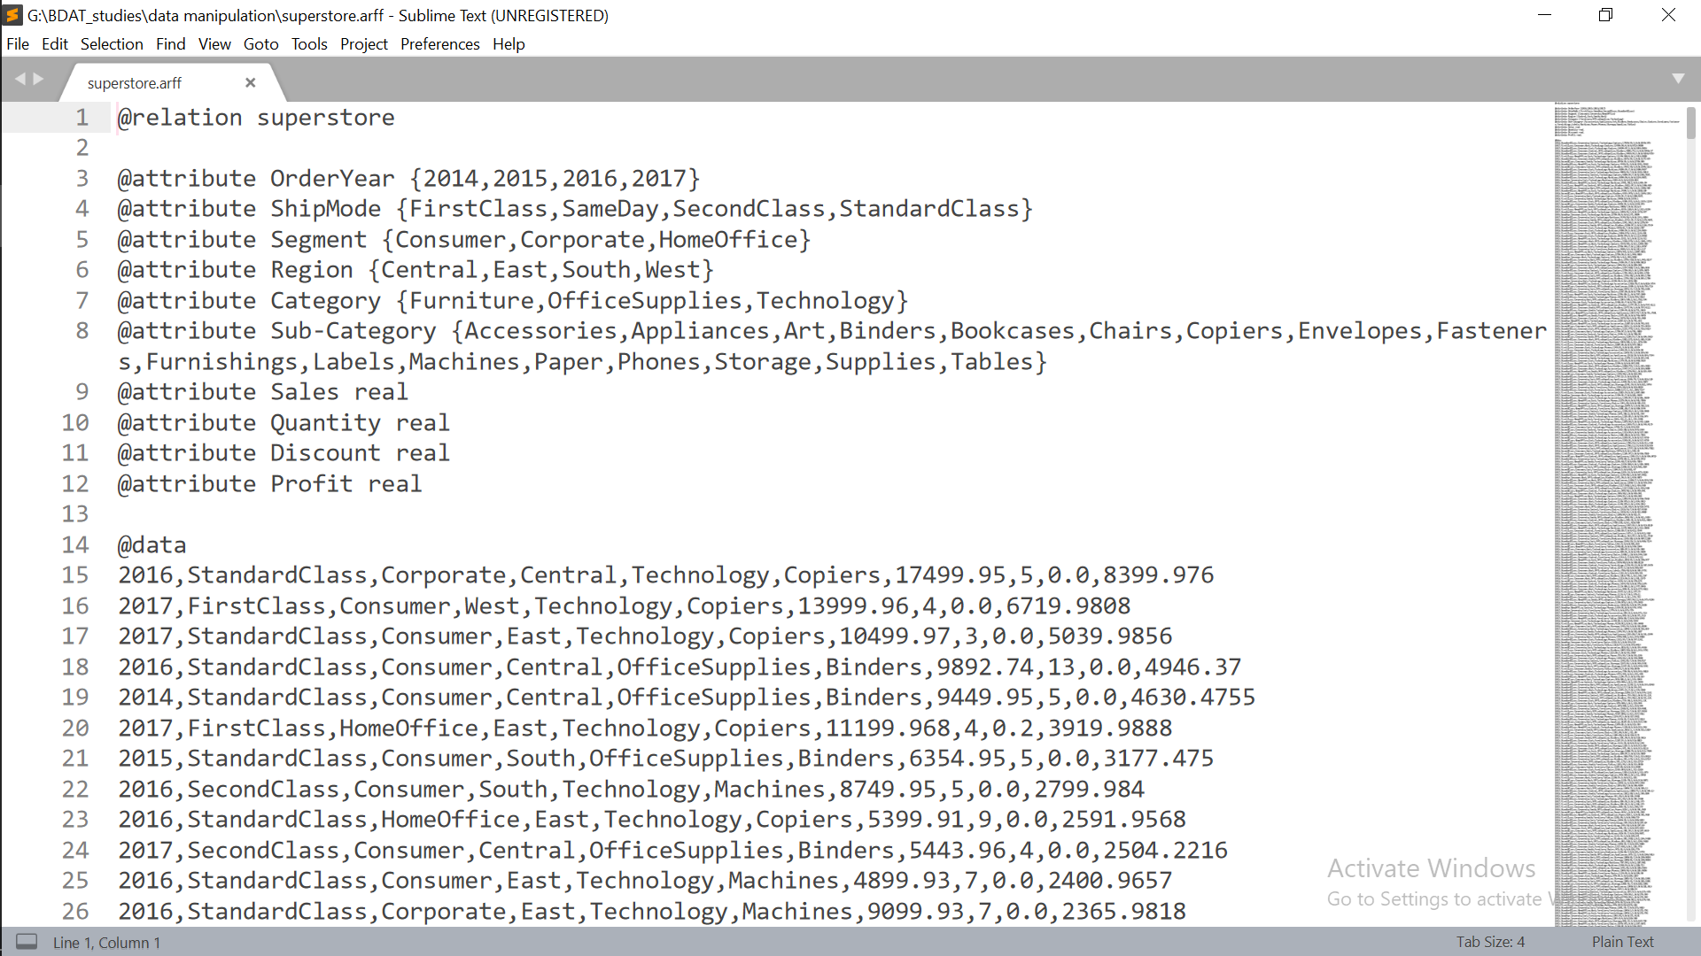
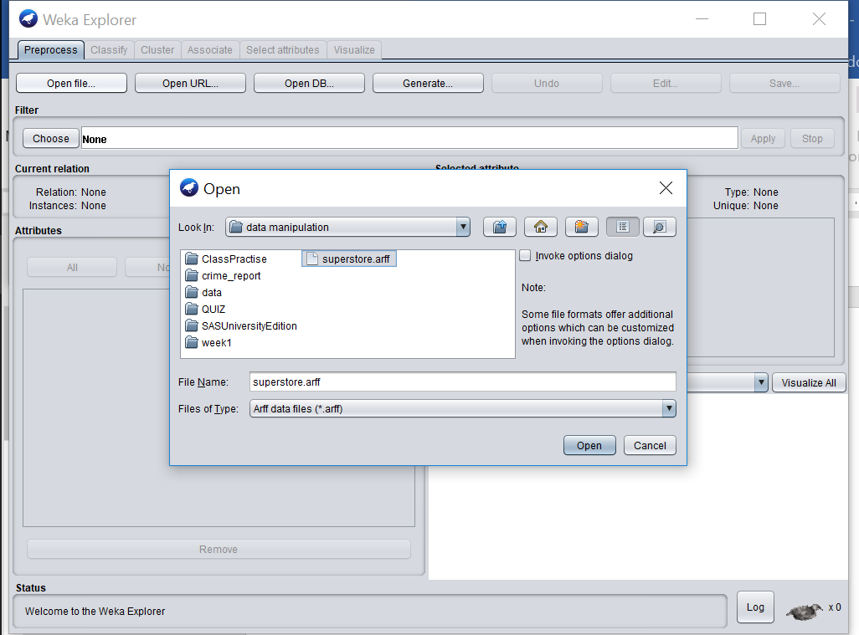
Notes:
Saved Excel file as in comma delimited format and then saved store.csv as .arff for WEKA by adding relation, attributes in file with respective data.
Opening superstore.arff file in Weka.

Slide 10
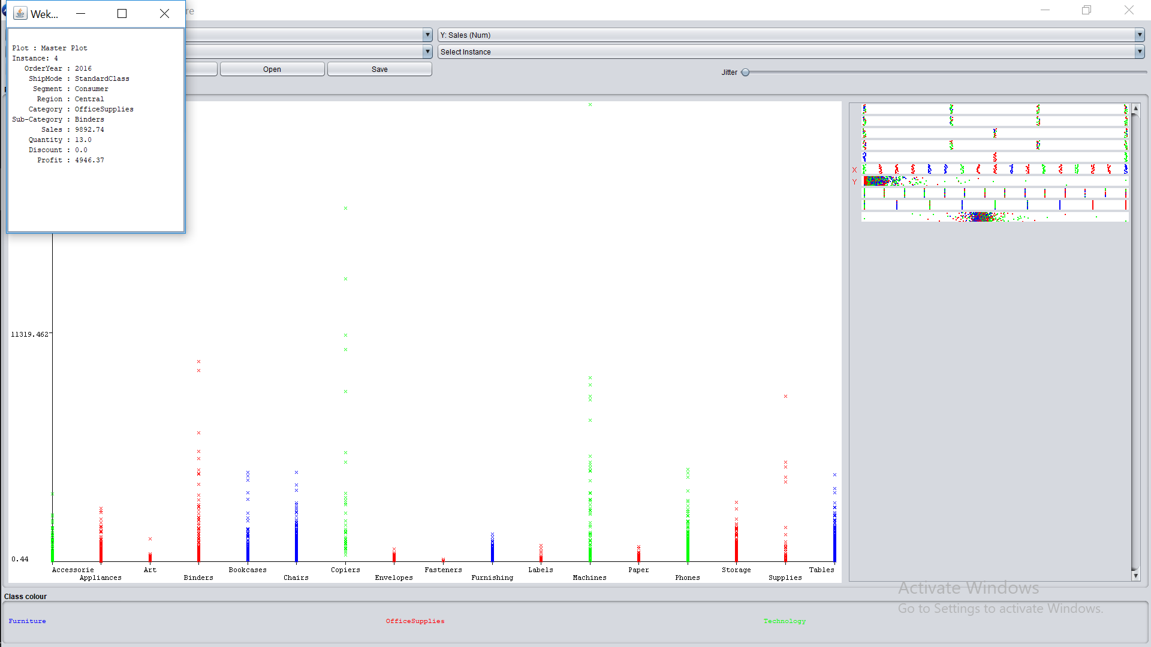
Notes:
Visualization of Sub-Categories and their corresponding sale. Moreover, it displays colour coding based on Main-Categories like: Furniture in blue, Office Supplies in red and Technology in Green.

Slide 11
WEKA result 1 : X-axis = Sub-Categories, Y-axis = Sales. Looking at ‘Office Supplies’ in red colour and ‘Binders’ as the sub-category appears to have a long stack. After clicking the last outlier, it mentions the details of outliers. This way company can know outliers and find the exact sale of a product.

Slide 12
How will the manufacturing department realize about their production quantity?
Analysis 2

Slide 13
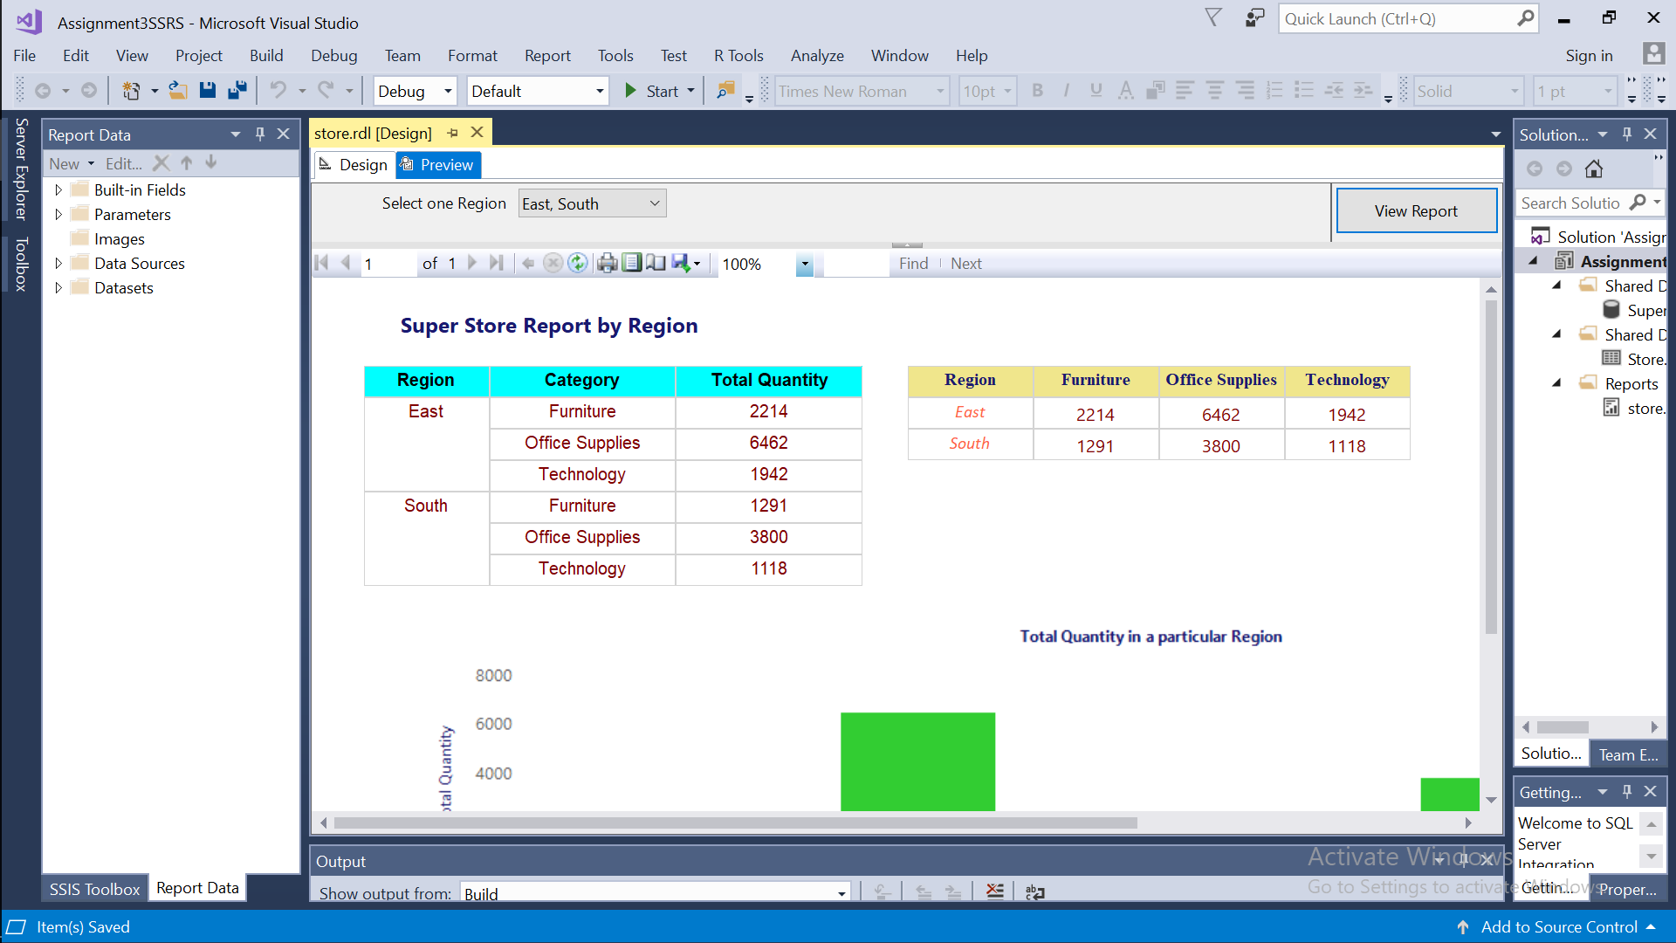
Notes:
Creating a report from SQL Server data source using SSRS tool. the screenshot displays Super Store’s data by region. The left side is a simple table whereas on the right side is a matrix wherein Category come as columns and data of total quantity is displayed in an effective manner.

Slide 14
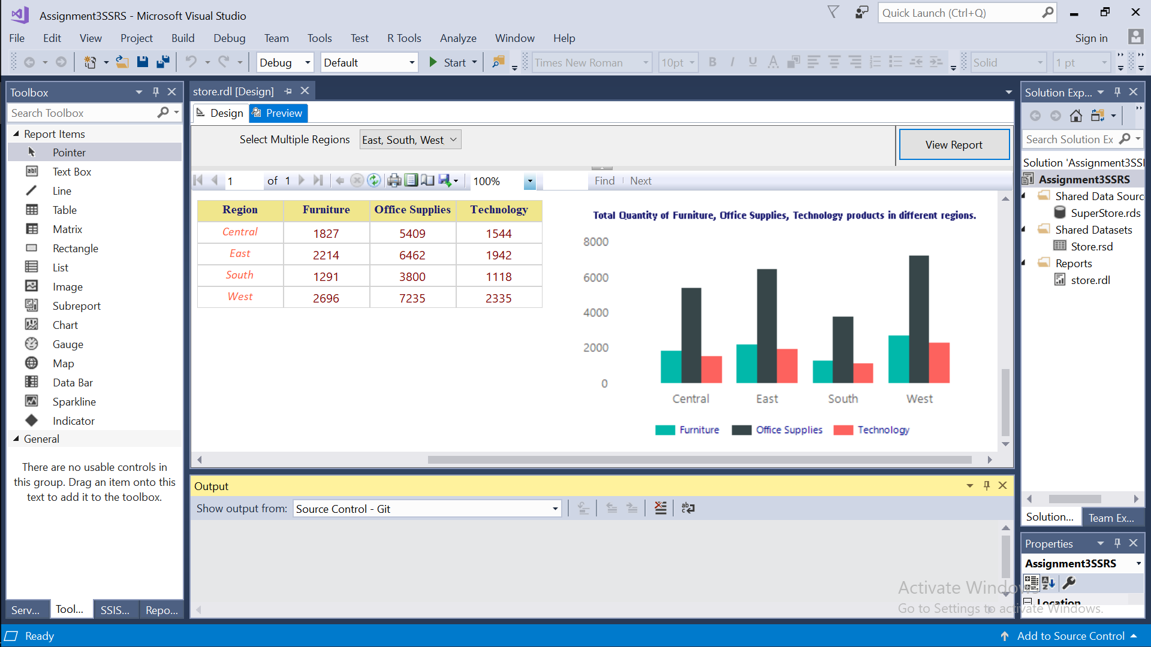
Notes:
Based on the above matrix table, the chart is displayed.

Slide 15
SSRS result 2 : X-axis = Regions, Y-axis = Total Quantity. After using a matrix table format the reader can get the exact view about total quantity produced in different regions. With the help of multi-selector for regions the difference can be made easily. For an instance, ‘Technology’ products produced in ‘South’ region is low.

Slide 16
How will the company know about maximum sales to build strategies?
Analysis 3

Slide 17
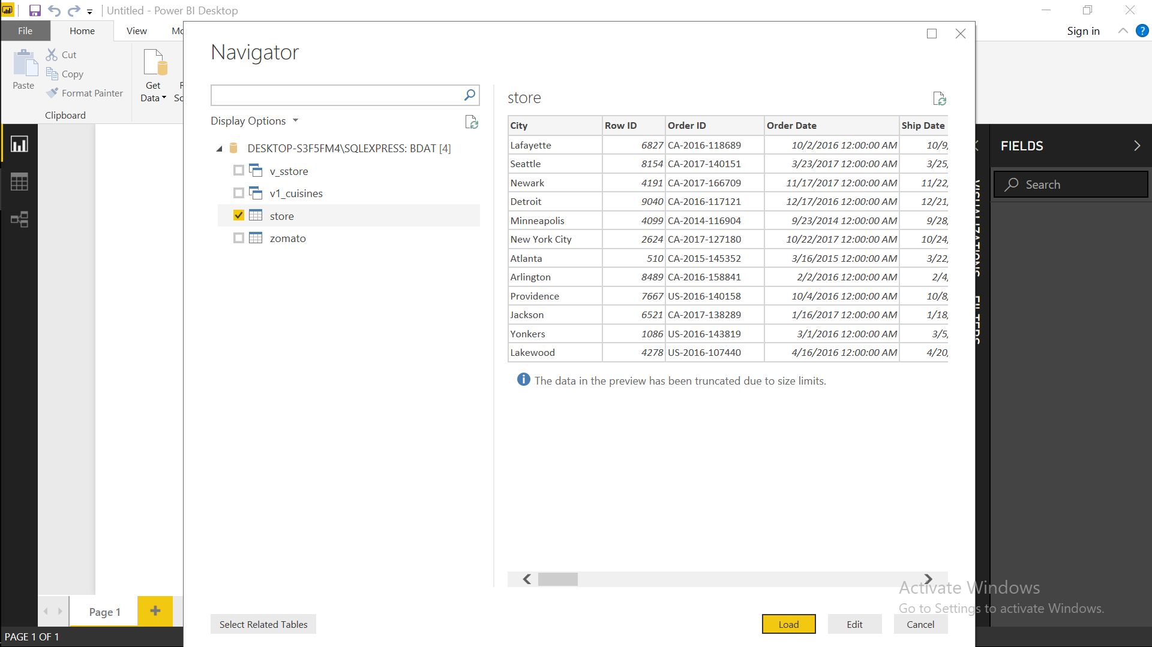
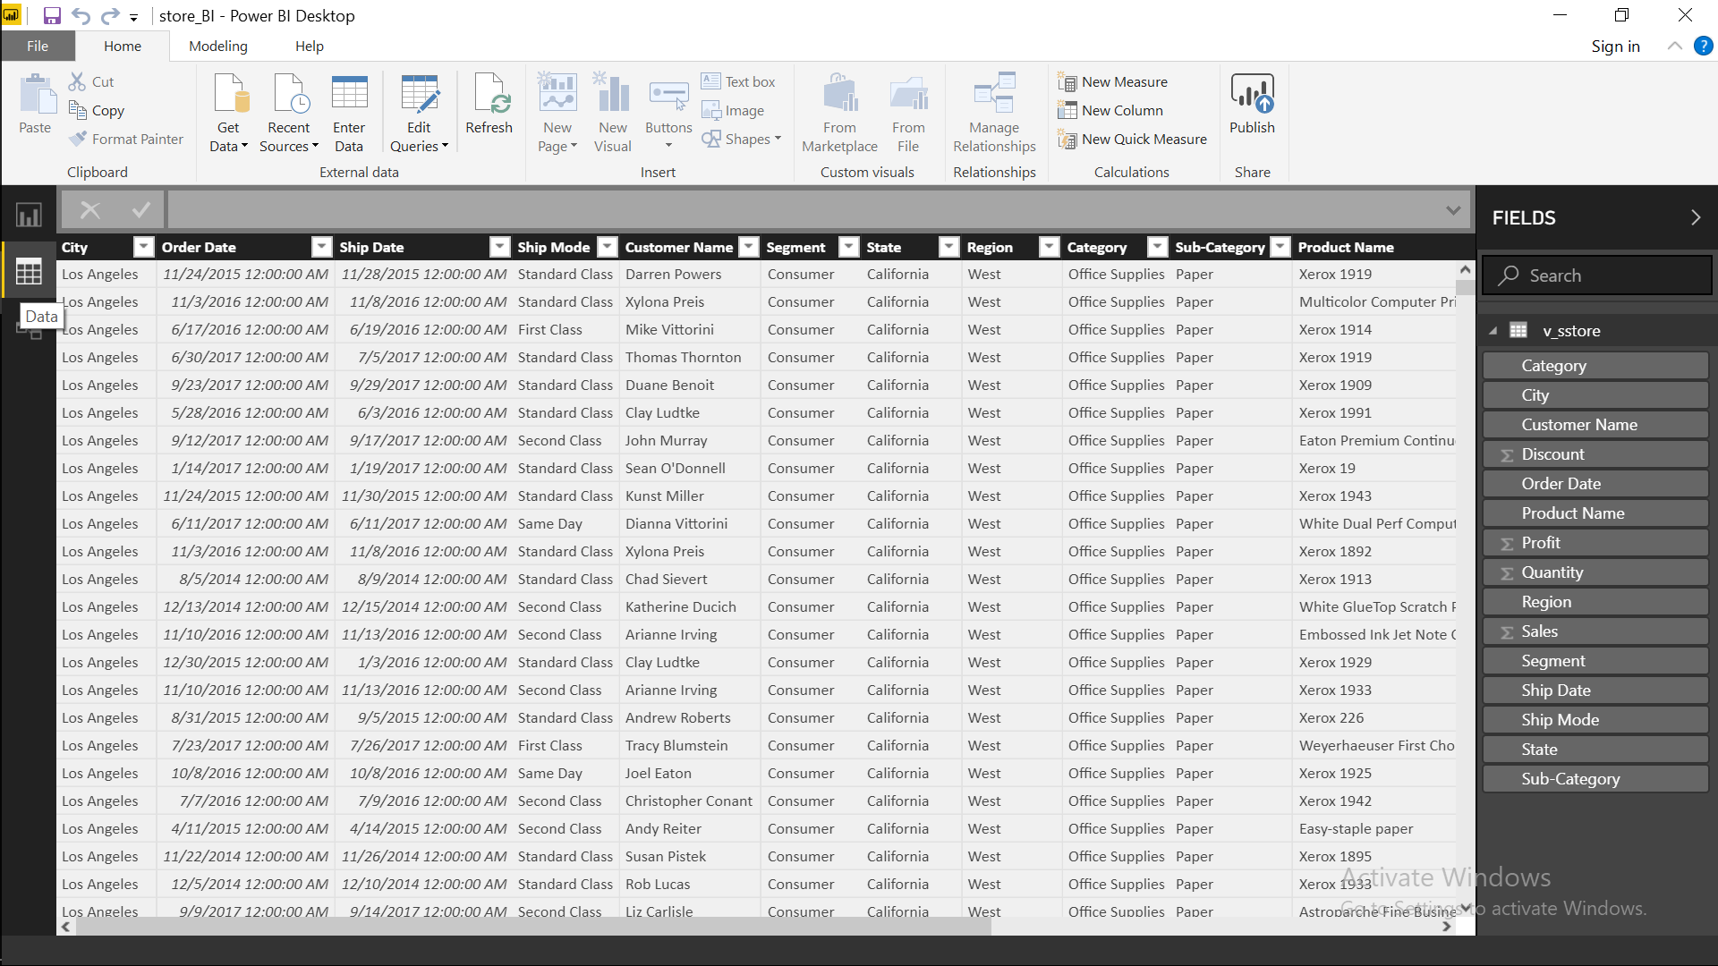
Notes:
Loading dataset from SSMS to Power BI and showing it in data tab.

Slide 18
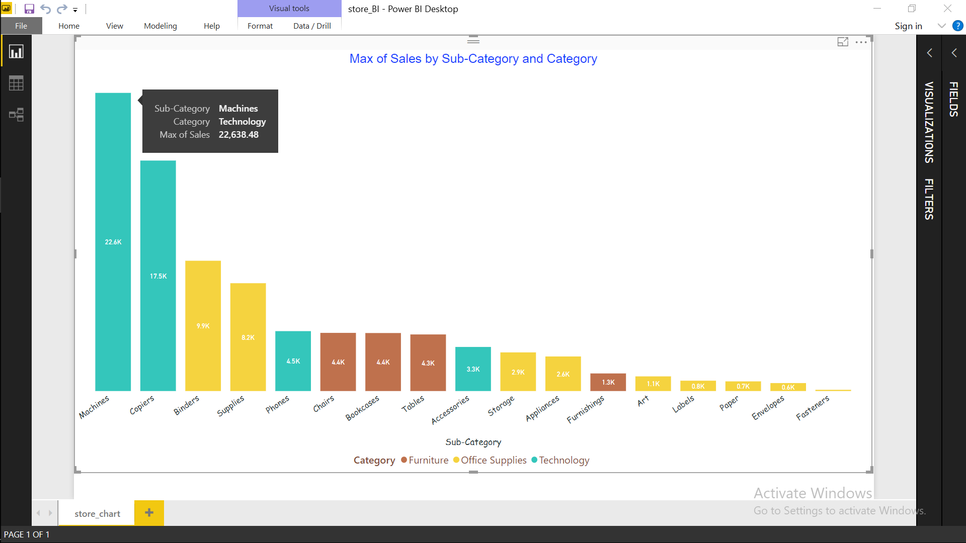
Notes:
The screenshot displays maximum sales of sub-categories in respect to giving an impression of main categories of a product by different shades.

Slide 19
Power BI result 2 : X-axis = Sub-Categories, Y-axis = Sales. Understanding about product sold and interpret assumptions for future is important. This is accomplished by using Power BI various filters and labels. By looking at the previous screenshot one can immediately tell that the maximum sold products are machines which can help company to persist that amount and put efforts to take it to the next level.

Slide 20
CONCLUSION
Cleaning data and finding outliers helps to do the analysis effectively. From a fresh data a systematic table can be formed for better assessment. This further can benefit a decision maker by building up a decent and expressive chart.
Lastly, all Business Intelligence tools are specific in their own way therefore, it depends on an individual to select them for different purposes.

Slide 21
REFERENCES
Presentation template by SlidesCarnival
Super Store Dataset
www.wikipedia.com
www.youtube.com
www.google.com

Slide 22
THANKS!
Any questions?
You can find me at
alvira.narshidani@mygeorgian.ca

